Slide 1
While you are waiting…
Check your calculator!
Find the square root of 943
Work out $\frac{7}{11}$ of 5676
Work out $−6−3×−7$
30.708…
3612
15

Slide 2
$$−5$$
$$3$$
$$−4$$
Put one number from the list in each box to give the greatest possible answer.
$$3$$
$$−$$
$$−5$$
$$+$$
$$−4$$
$$=4$$
Number : Negative Number

Slide 3
Write $4^{3}×8^{5}$ as a single power of $2$
$$2^{21}$$
Number : Laws of indices

Slide 4
$A=\frac{b}{c}$
Find the upper bound for $A$ given that
$b=$ 4.5 to 1 decimal place and
$c=$ 3.67 to 3 significant figures
Write all the figures on your calculator display
1.241473397…
Number : Bounds

Slide 5
A code has four digits, each from 0 to 9
None of the digits in the code are repeated.
How many possible codes are there?
5040
Number : Product rule for counting

Slide 6
Simplify ${\left(4k^{5}\right)}^{3}÷2k^{−2}$
$$32k^{17}$$
Algebra : Simplification

Slide 7
Expand and simplify $5\left(d+3\right)+2(7−2d)$
$29+d$
Algebra : Expand brackets

Slide 8
$$s=ut+\frac{1}{2}at^{2}$$
Find the value of $s$ when $u=3, a=9.8$ and $t=5$
$137.5$
Algebra : Substitute values

Slide 9
Factorise $25p^{2}−9q^{2}$
$\left(5p+3q\right)\left(5p−3q\right)$
Algebra : Difference of two squares

Slide 10
Make $x$ the subject of the formula $h=\frac{x−3}{5}$
$x=5h+3$
Algebra : Change subject of a formula

Slide 11
A sandwich costs £$s$ and a chocolate bar costs £$c$.
Write an expression for the total cost of buying five sandwiches and three chocolate bars.
$$5s+3c$$
Algebra : Forming an expression

Slide 12
Write the expressions on the cards as single fractions.
$\frac{k}{3}−\frac{k}{5}$
$\frac{k}{8}×\frac{12}{k^{2}}$
$\frac{k+2}{(k+1)(k+2)}÷\frac{3k+6}{k^{2}+k}$
$$\frac{2k}{15}$$
$$\frac{3}{2k}$$
$$\frac{k}{3(k+2)}$$
Algebra: Algebraic fractions

Slide 13
Tommy is $x$ years old.
Dexter is twice as old as Tommy.
Whitney is 5 years younger than Dexter.
The sum of their ages is 35
Form an equation in $x$ and work out Whitney’s age.
$5x−5=35$
Whitney is 11
Algebra: Set up and solve an equation

Slide 14
Solve the simultaneous equations
$$x^{2}+y^{2}=41$$
$$y−x=1$$
$x=4, y=5$
$x=−5,y=−4$
Algebra: Simultaneous equations linear/quadratic

Slide 15
Find the gradient of the straight line with equation $3x−2y=6$
$\frac{3}{2}$
Algebra: Gradient of a straight line graph

Slide 16
Write 195 minutes in hours.
3.25 hours
RPRoC : Time

Slide 17
A pair of shoes costs £45.
The price is decreased by 15% in a sale.
What is the price of the shoes in the sale?
£38.25
Another pair of shoes cost £34 in the sale
How much did the shoes cost before the sale?
£40
RPRoC : Percentage decrease & Reverse percentage

Slide 18
A car loses 15% of its value in the first year and 10% of its remaining value each following year.
Jack’s car costs £18 000 when new
Find the value of Jack’s car after three years.
£12 393
RPRoC : Depreciation

Slide 19
Dexter and Ron share £40.
Dexter gets £25.
Find the ratio of the amount Dexter has to the amount Ron has, giving your answer in its simplest form.
5 : 3
RPRoC : Write as a ratio

Slide 20
On a school trip, there are 12 teachers and 105 students.
Write the ratio of teachers to students in the form 1 : $n$.
1 : 8.75
RPRoC : 1 : $n$ form

Slide 21
Alex and Ron share sweets in the ratio 5 : 7
Ron has 30 more sweets than Alex.
How many sweets does Alex have?
75
RPRoC : Share in a ratio

Slide 22
Alex needs 300 g of flour to make 12 pancakes. How much flour does she need to use to make 20 pancakes?
500 g
RPRoC : Direct proportion

Slide 23
Rosie cycles 24 miles in 3 hours.
She then travels a further 18 miles in 2 hours.
What is her average speed for the whole journey?
8.4 mph
RPRoC : Compound measures

Slide 24
The population of a city is increasing by 7.5% a year.
4 million people live in the city now.
Work out the population of the city in 5 years’ time, giving your answer to 3 significant figures.
5 740 000
RPRoC : General iterative processes

Slide 25
B
47º
C
A
$∠$ABD $=$ 47$°$
Which other angle must be 47$°$?
Give a reason for your answer.
D
E
∠ADE
Alternate segment theorem
Geometry: Circle theorems

Slide 26
Find the area of the trapezium.
14cm
5cm
4cm
3cm
50 cm²
Geometry: Area of a trapezium

Slide 27
BE is parallel to CD.
AB $=$ 8 cm, BC = 4 cm, BE = 6 cm
Work out the length of CD.
A
8 cm
B
4 cm
C
6 cm
E
9 cm
D
Geometry: Similar triangles

Slide 28
Find the length of AB
C
40 cm
15 cm
A
B
37.1 cm
Geometry: Pythagoras’ Theorem

Slide 29
C
Work out the size of $∠$ACB.
15 cm
A
B
20 cm
53.1$°$
Geometry: Trigonometry

Slide 30
B
8 cm
15 cm
A
30 cm
The diagram shows a cuboid with dimensions 30 cm,
15 cm and 8 cm.
Work out the angle diagonal AB makes with the base of the cuboid.
13.4$°$
Geometry: Trigonometry in 3-D

Slide 31
$a=\left(\begin{aligned}3 \\ −5\end{aligned}\right)$, $b=\left(\begin{aligned}2 \\ 4\end{aligned}\right)$, $c=\left(\begin{aligned}4 \\ −3\end{aligned}\right)$
Show that 2$a+b$ is parallel to $c$
2$a+b=\left(\begin{aligned}6 \\ −10\end{aligned}\right)+\left(\begin{aligned}2 \\ 4\end{aligned}\right)=\left(\begin{aligned}8 \\ −6\end{aligned}\right)=$ 2 $×\left(\begin{aligned}4 \\ −3\end{aligned}\right)$
As 2$a+b$ is a multiple of $c$, they are parallel.
Geometry: Column Vectors

Slide 32
A bag contains 8 Red and 3 Green counters
Two counters are removed without replacement.
Find the probability they two counters are not the same
colour.
$\frac{24}{55}$
Probability: Dependent combined events

Slide 33
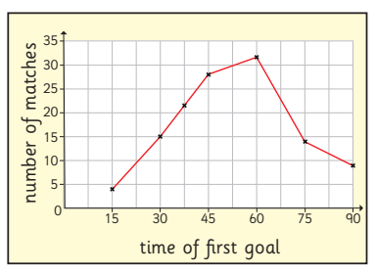
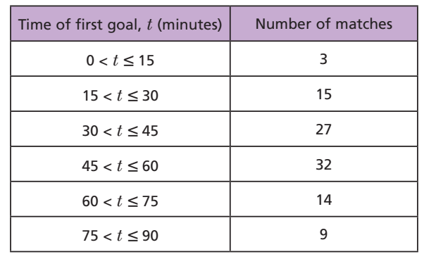
A frequency polygon has been drawn to show the data in the table.
What mistake has been made?
The frequencies should be plotted at the midpoints of the intervals.
Statistics: Frequency polygon

Slide 34
The table shows the frequency densities of the ages of the members of an online book group.
Work out the percentage of the members aged over 60
Age, $a$, years | Frequency density
$$20<a≤40$$ | 1.6
$$40<a≤55$$ | 2
$$55<a≤60$$ | 2.4
$$60<a≤65$$ | 3.6
$$65<a≤80$$ | 3
46%
Statistics: Histogram

